Slide 1

MTH302 Probability and Statistics
Lecture #0

Slide 2
LTP and Credit Details
Program Name: Bachelor of Technology Program Batch: 2022
This Bachelor Degree program has a minimum duration of 4 years and is offered under Semester system through Regular mode.
LTP and Credit Details of MTH302 Teaching Model:
L-T-P: 3-0-0 (3 Lectures, 0 Tutorial, 0 Practical)
Credit: 3

Slide 3

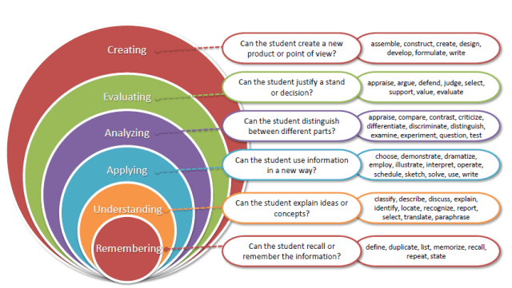
Revised Bloom’s Taxonomy

Slide 4
Course Outcomes
Through this course students should be able to…
CO1 :: recall the basic principles of probability and Bayes theorem.
CO2 :: discuss the concept of random variables and its characterizations.
CO3 :: apply probability distributions to find the solution of different engineering problems.
CO4 :: demonstrate sample, population and statistical inference.
CO5 :: understand hypothesis testing and its applications.
CO6 :: analyze relationships among the variables through correlation and regression.

Slide 5
Program Outcomes
PO1 Engineering knowledge:
Apply the knowledge of mathematics, science, engineering fundamentals,and an engineering specialization to the solution of complex engineering problems.
PO2 Problem analysis:
Identify, formulate, research literature, and analyze complex engineering problems reaching substantiated conclusions using first principles of mathematics, natural sciences, and engineering sciences.
PO12 Life-long learning
Recognize the need for, and have the preparation and ability to engage in independent and life-long learning in the broadest context of technological change.

Slide 6
Course Outcomes (COs) to Program Outcome(POs) Relationship COs to POs mapping
Course code: MTH302 Program Name: Bachelor of Technology Program Batch: 2022
1=Low :: 2=Moderate :: 3=High
Outcomes | PO1: Engineering knowledge: Apply the knowledge of mathematics, science, engineering fundamentals, and an engineering specialization to the solution of complex engineering problems. | PO2 : Problem analysis::Identify, formulate, research literature, and analyze complex engineering problems reaching substantiated conclusions using basic principles of engineering and sciences. | PO12: Life-long learning: Recognize the need for, and have the preparation and ability to engage in independent and life-long learning in the broadest context of technological change.
CO1 :: recall the basic principles of probability and Bayes theorem. | 3 | 2 | 2
CO2 :: discuss the concept of random variables and its characterizations. | 3 | 2 | 2
CO3 :: apply probability distributions to find the solution of different engineering problems. | 3 | 1 | 2
CO4 :: demonstrate sample, population and statistical inference. | 3 | 2 | 2
CO5 :: understand hypothesis testing and its applications. | 3 | 2 | 2
CO6 :: analyze relationships among the variables through correlation and regression. | 3 | 2 | 2

Slide 7

The course contents
Unit 1 : Basics of probability
Sample Space and Events
counting sample points
Probability of an Event
additive rules
conditional probability
multiplicative rules
Bayes' Rule

Slide 8
Unit 2 : Random variable and its characterization
Discrete and Continuous random variable
Joint probability distributions
mean of a random variable
variance and covariance of random variables
Chebyshov's theorem

Slide 9

Unit 3: Special distributions
The Bernoulli process, binomial distribution
negative binomial and geometric distributions
Poisson distribution and the Poisson process
gamma and exponential distributions
normal distribution

Slide 10
Unit 4: The Central Limit Theorem andPoint Estimation
The central limit theorem,
unbiased estimators,
consistent estimator,
maximum likelihood estimation

Slide 11
Unit 5: Hypothesis Testing
Types of error
Goodness of fit
Student t test
F-test
Z-test
Chi square Test

Slide 12
Unit 6: Correlation and regression
scatter plots
linear correlation
regression
fitting the line and curve
Prediction using regression
simple regression

Slide 13
We dare you to go through a day in which you never consider or use probability.

Slide 14


Slide 15
Did you check the weather forecast?
Did you decide to go through the drive through lane vs walk in?
We are constantly creating hypotheses, making predictions, testing, and analysing.
Our lives are full of probabilities!
Statistics is related to probability because much of the data we use when determining probable outcomes comes from our understanding of statistics.

Slide 16

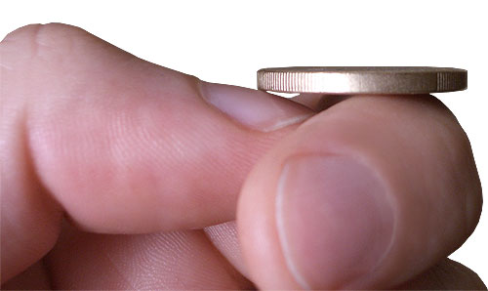
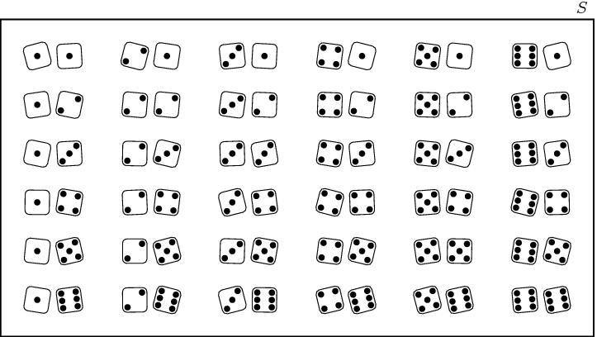


Slide 17
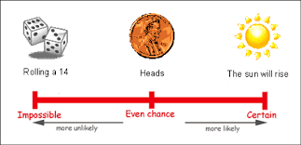

Slide 18
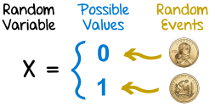

Slide 19
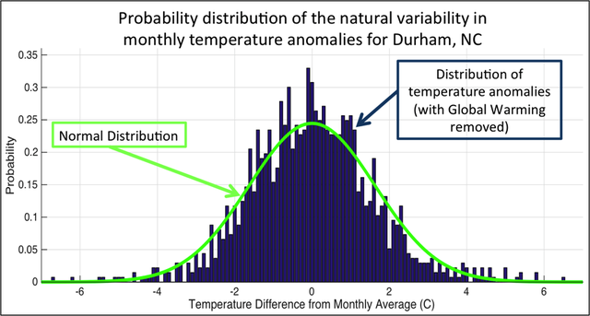

Slide 20
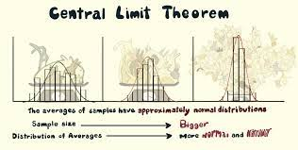

Slide 21
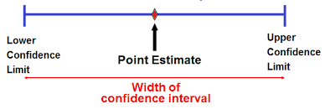

Slide 22
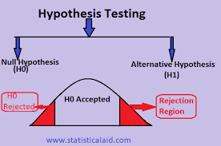

Slide 23
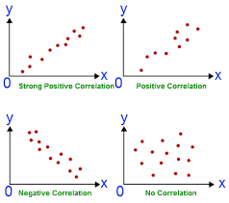

Slide 24
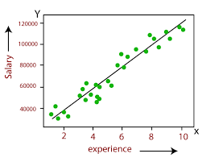

Slide 25
Course Assessment Model
Marks break up
Attendance 5
CA (Two best out of three tasks) 25
MTE 20
ETE 50
Total 100

Slide 26
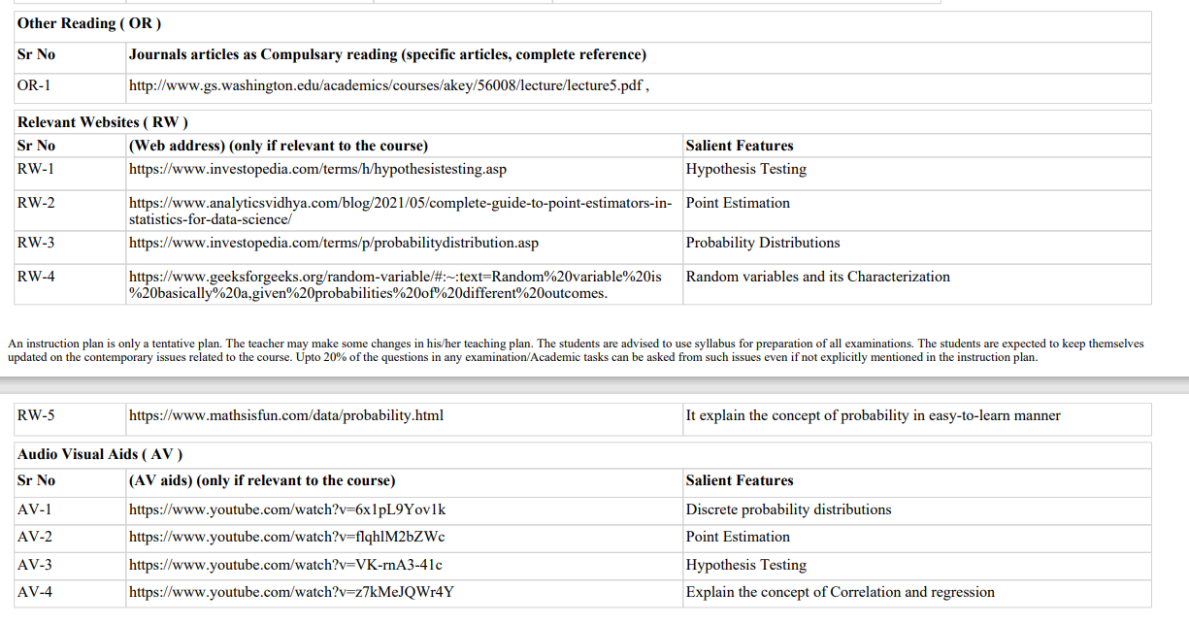
Relevant Resources Which Could Be Used for Better Understanding of the Course.

Slide 27

Course details
Text Book
1. PROBABILITY AND STATISTICS FOR ENGINEERS AND SCIENTISTS by RONALD E. WALPOLE, RAYMOND H. MYERS,SHARON L. MYERS, AND KEYING YE, PEARSON Reference Books
PROBABILITY STATISTICS AND RANDAM PROCESSES by T VEERARAJAN, MCGRAW HILL EDUCATION
FUNDAMENTALS OF MATHEMATICAL STATISTICS by S.C.GUPTA AND V.K.KAPOOR, SULTAN CHAND & SONS (P) LTD.

Slide 28
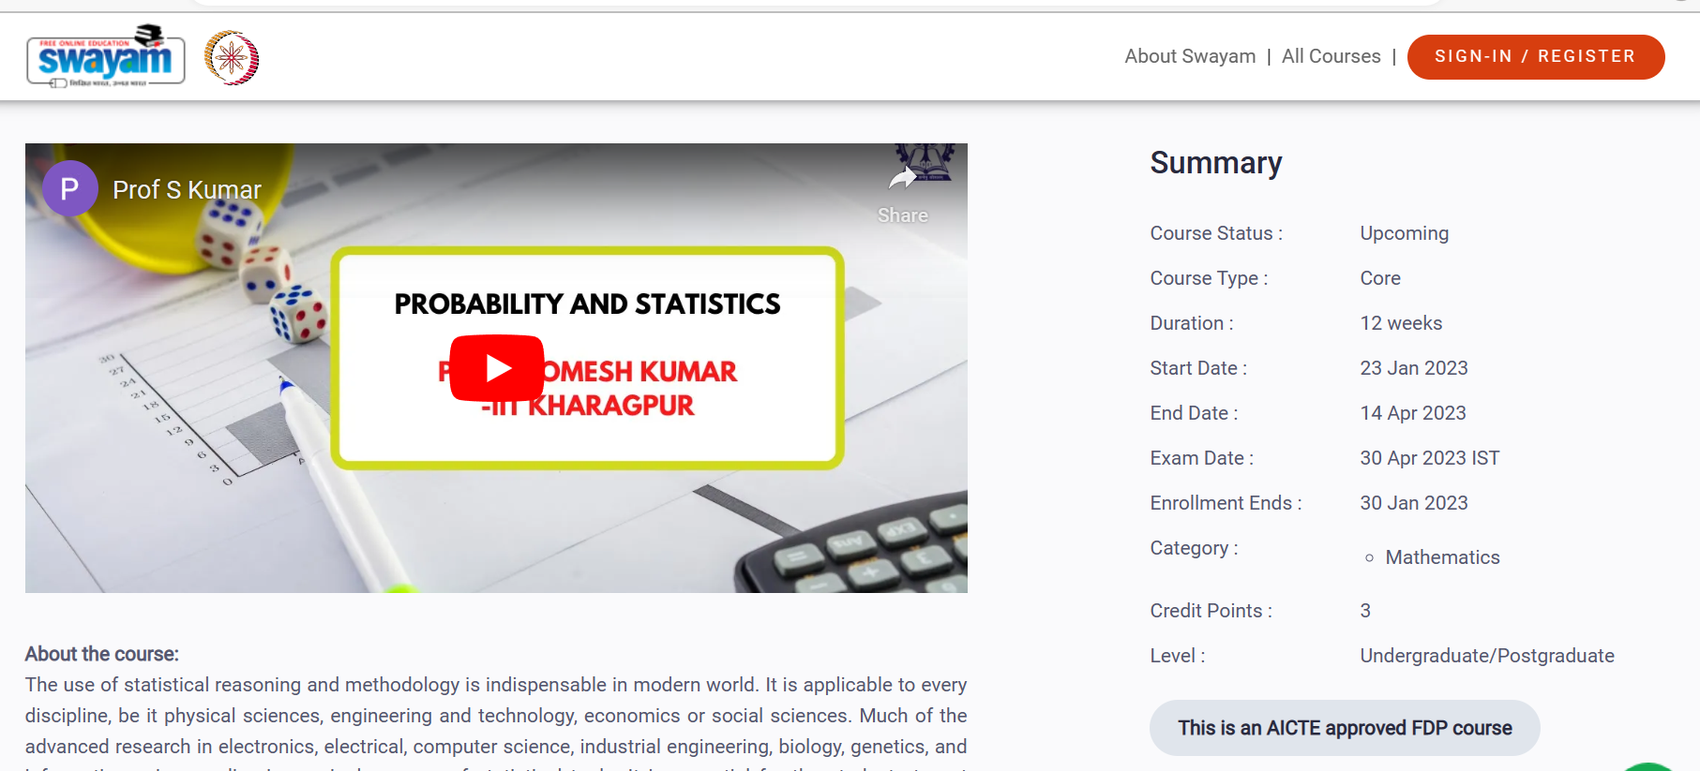
MOOC Associated With the Course
Link-Probability And Statistics - Course (nptel.ac.in)

Slide 29

Life Learning

Slide 30
Thank You

